Slide 1
Inventory Forecasting and Analytics for Tata motors company – A case study for one Dealership Proposal Presentation
REVA Academy for Corporate Excellence (RACE)
Name: THANISH SHEKAR
Program: MSc in Business Analytics
Batch: BA11
SRN: R22MSB07
Date: 29/06/24
Capstone 1/2: 1
race.reva.edu.in

Slide 2
Agenda
01
Introduction
05
Project Methodology
Background | Current status | Why this study
Conceptual Framework | Research Design
02
Literature Review
06
Proposed Solution
Seminal works | Summary | Research Gap
03
Problem Statement
07
Detailed Scope of Work
Technical/Functional Problem
08
References
04
Project Objectives
Journal Articles | White Papers
Primary & Secondary Objectives | Expected Outcome

Slide 3

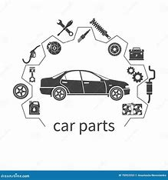
Background Information
Background | Current status | Why this study
Leading automotive manufacturer with a global presence.
Critical need for effective inventory management to meet customer demands.
Tata Motors, along with other industry players, grapples with several challenges:
Stockouts
Excess Inventory
Long Lead Time
Inefficient Order Fulfillment

Slide 4
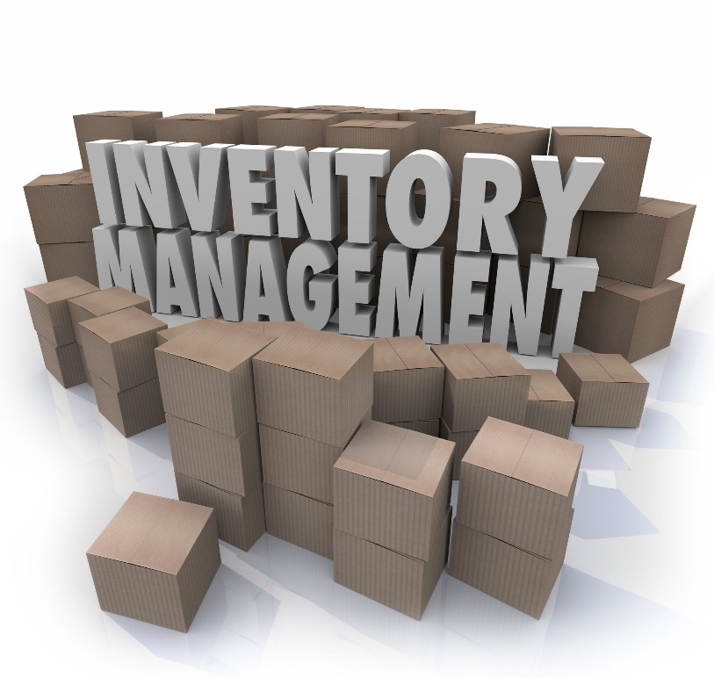
Background Information
Background | Current status | Why this study
Need for the Study:
Using the power of data analytics and predictive modeling, We can help the Tata motors Dealership to significantly enhance its demand forecasting capabilities and have a platform to make it efficient.
The following benefits can be derived:
Enhanced Demand Forecasting
Optimized Inventory Management
Minimized Carrying Costs
Improved Customer Satisfaction

Slide 5
Literature Review
Seminal works | Summary | Research Gap
No. | Title | Author and Year | Journal | Insights | Research Gaps/Comments
1 | Large-Scale Optimization in Online-Retail Inventory Management | Annie I-An Chen S.M., Massachusetts Institute of Technology (2017) | MIT | strategically lengthen the lead times of some fulfillment centers to create staggering. demand variability and per-unit overage or underage cost parameters have a nonlinear effect on the overall cost.
2 | Inventory – forecasting: Mind the gap | Thanos E. Goltsos, Aris A. Syntetos, Christoph H. Glock, George Ioannou | European Journal of Operational Research | forecast as the (best possible) genuine expectation of how much demand is going to be for a particular SKU Various manipulating characteristics of demand, in pursuit of inventory and ultimately supply chain efficiencies.

Slide 6
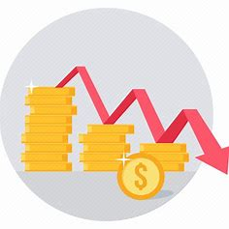
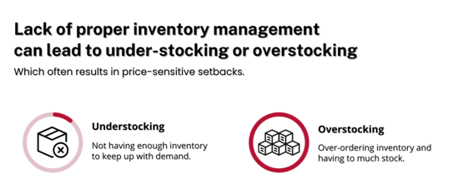

Problem Statement
Technical/Functional Problem
Challenge: The inability to predict future demand accurately, leading to either overstocking or stockouts, which impacts both operational costs and customer satisfaction.
Revenue
Customer Dissatisfaction

Slide 7
Project Objectives
Primary & Secondary Objectives | Expected Outcome
Primary Objective: Ensure that dealerships can maintain optimal inventory levels, reduce holding costs, minimize stockouts, and improve overall customer service by having the right parts available at the right time.
Objective 1: Build a demand prediction model to forecast the demand for spare parts and components over the next 2 to 3 months.
Objective 2: Develop a Historic Dashboard using Power BI for analysis of metrics and Dimensions
Objective 3: Automate the data movement using an ETL tool and integrating to Azure
Objective 4: Develop a dashboard to recommend actionable insights to business stakeholders based on current data.

Slide 8
Project Methodology
Conceptual Framework | Research Design
To achieve the Goals, we need:
Tata motors Dealership Inventory Data
Azure Cloud platform
Business Understanding
Data Understanding
Modeling
Tech Stack Involved:
Data Bricks
Data Factory
Azure SQL
PowerBI
Machine Learning
CI/CD

Slide 9
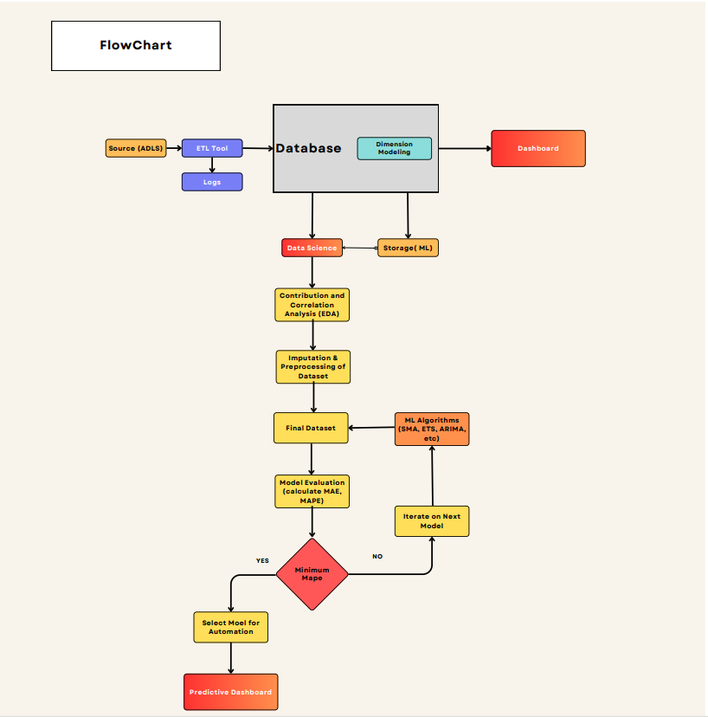
Project Methodology
Conceptual Framework | Research Design
Flowchart.pdf

Slide 10
Proposed Solution
Inventory Management Platform
Components of the Solution:
Data collection and Integration
Automating the Data streamline
Historical Dashboard & Predictive Dashboard
Model Implementation and Deployment
Monitoring and Continuous Improvement
Benefit to Business:
Improved Inventory Management
Cost Savings
Enhanced Customer Satisfaction
Increased Operational Efficiency

Slide 11
References
Journal Articles | White Papers
Inventory – forecasting: Mind the gap Thanos E. Goltsos a , Aris A. Syntetos a,∗ , Christoph H. Glock b , George Ioannouc , Inventory – forecasting: Mind the gap – ScienceDirect
Fildes, R., Ma, S., & Kolassa, S. (2020). Retail forecasting: Research and practice. International Journal of Forecasting. h

Slide 12


